Slide 1
Unmanned Aerial Vehicle / Drone Insurance, Liability & Registration
Office of Legal Affairs / Risk Management
The University of Texas System Office of Risk Management
University Police

Slide 2
Introduction
Jenny Henry: Office of Legal Affairs
Chief Zach: University Police
Eric Agnew: UT System Office of Risk Management
Annette Rogers: UTD Risk Management

Slide 3
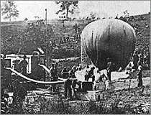
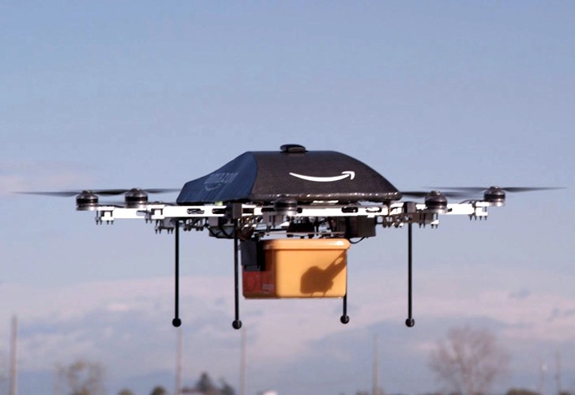
History and Overview
1849
1917
2013
1935
2005
2021
First use of drones
First UAV – Ruston Proctor Aerial Target and Sperry Aerial Torpedo
de Havilland DH82B Queen Bee
FAA banned UAVs in US airspace without a waiver
Amazon announced plans to use delivery drones
868,421 drones registered with the FAA
1863
US patent for an unmanned aerial bomber
2016
FAA introduced new regulations for commercial use of UAVs
Notes:
1849- First use of drones
Austrian forces used explosive-carrying balloons to bomb Venice
The campaign was not very successful but is generally accepted as the first such use of drones
1863- US patent for an unmanned aerial bomber (pictured)
In February 1863, Charles Perley, an inventor from NYC, registered a patent for an unmanned aerial bomber
It was used by both the Union and the Confederacy during the Civil War but with limited success
Inaccurate and dangerous
1917- First Unmanned Aerial Vehicle
Some debate whether the Ruston Proctor Aerial Target or the Sperry Aerial Torpedo was the first unmanned aerial vehicle
Both were radio controlled thanks to Nikola Tesla’s recent advances with remote/radio control
Neither saw combat but were instead used for target practice by anti-aircraft gunners after WWI
1935- de Havilland DH82B Queen Bee
First successful military drone
Believed to be the inspiration behind the name drone, after stingless male bees
2005- FAA banned UAVs in US airspace without a specific waiver
Had to apply for and be granted a Certificate of Waiver or Authorization (COA) in order to operate a drone
Only issued 50 COAs in the first two years
2013- Amazon announced plans to use delivery drones (pictured-2020)
Jeff Bezos announced plans to start using drones to delivery Amazon orders
Sparked increased interest in drones
In August 2020, Amazon got FAA clearance to operate their drone fleet, but it has yet to widely implement the program
2016- FAA introduced new regulations for commercial use of UAVs
Updated Part 107 (small unmanned aircraft rule) to make it easier to use UAVs for commercial use
Still had strict safety requirements and required remote pilots to be certified
2021- 868,421 drones registered with the FAA
As of March 1, 2021:
868,421 registered drones
375,929 commercial
492,492 recreational
215,364 certified remote pilots
Sources:
https://www.businessinsider.com/a-history-of-commercial-drones-2016-12
https://www.economist.com/technology-quarterly/2017-06-08/civilian-drones
https://www.digitaltrends.com/cool-tech/history-of-drones/
http://ffden-2.phys.uaf.edu/webproj/211_fall_2018/J-Rod_Maltos/history_3rd.html
https://www.pbs.org/wgbh/nova/spiesfly/uavs_03.html
https://www.faa.gov/uas/resources/by_the_numbers/
https://www.ctie.monash.edu/hargrave/rpav_home.html#Beginnings
https://www.faa.gov/uas/resources/policy_library/media/frnotice_uas.pdf
https://www.faa.gov/uas/media/Part_107_Summary.pdf
https://www.faa.gov/news/updates/?newsId=86305
https://www.amazon.com/Amazon-Prime-Air/b?ie=UTF8&node=8037720011

Slide 4
History and Overview
Current Uses
Future Uses
Photography
Agriculture
Construction
Inspection
Public Safety
Entertainment
Delivery
Medical Transport
Energy
Notes:
Current Uses:
Photography
One of the original uses of drones and one of the most common
Agriculture
Can be used to survey agricultural plots to more efficiently allocate resources
Can be used for research surveys
Construction
Streamlines the grading process by quickly creating a topographic survey
Can quickly and accurately take measurements
Helping to digitalize construction and can check progress of work
Inspection
Can be used to inspect buildings, turbines, solar farms, pipelines, electrical equipment, etc.
Can inspect for storm damage
Can safely inspect potentially dangerous areas
Public Safety
Can be used to monitor crowds
Can be used to create 3D models of accidents
Can be used to survey disaster areas
Entertainment
Used by Disney World
Have been used in the Olympics Opening Ceremony
Have been used in the Super Bowl Halftime Show
Future Uses:
Delivery
Currently being developed by Amazon, google, UPS
Could be used for food delivery similar to Starship robots (tobors)
Medical Transport
Currently being used to deliver covid vaccines
Could be used in the future to deliver medical supplies and/or to transfer blood or organ donations
UC Davis Health has begun using drones to transport between different labs/buildings
Energy
High altitude tethered drones may eventually be used as flying wind turbines
Could also be used to provide internet access

Slide 5
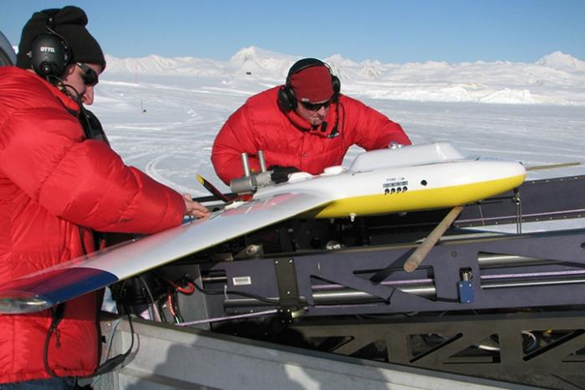
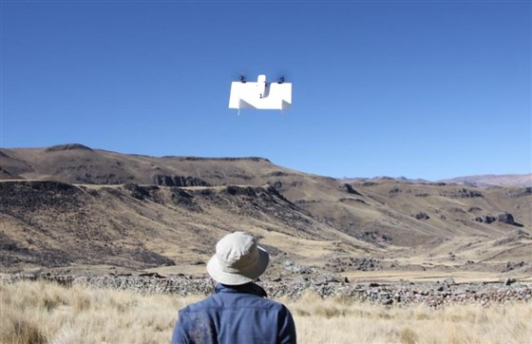
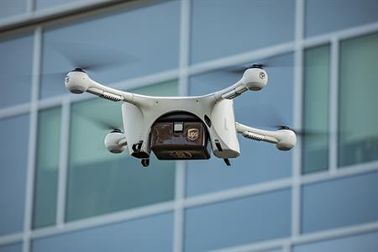
Drones at Other Universities
MIT
Columbia
Vanderbilt
UC Davis Health
Notes:
MIT:
Created insect-like drones
Goal is to one day be used to pollinate crops or perform inspections of machinery in confined areas
Weighs 0.6 grams (about the size of a large bumblebee)
More resilient than traditional drones
Potential to operate in closed, cramped spaces
Lamont-Doherty Earth Observatory (Columbia University):
Miniaturized tech traditionally used on ships or manned aircraft, such as:
Infrared imaging
Hyperspectral cameras
Broadband long wave/short wave radiation
LiDar
Measuring sea ice topography, thickness, movement (pictured)
Mapping lava flows
Monitoring coastal erosion
Monitoring coral bleaching
Monitoring mangrove communities
Measuring air pollution
Vanderbilt:
Used to map and catalogue archaeological sites
Tested by surveying the abandoned Inca settlement of Mawchu Llacta in Peru
Research can also be applied to surveying disaster sites and tracking the progress of global warming
University of California System:
UC has more than 600 internally registered drones
California Heartbeat Initiative
UC got a $2.2M grant to study hydrology across the state to help make advance predictions about California’s water flow
Will use drones to check forest moisture content
UCLA- drones were used to create a VR version of the UCLA campus to show to the International Olympic Committee
UCLA- drones used to film sports practices for analytics
UCSD- used drones to test buildings before, during, and after an earthquake
UCSD Health- Transport medical supplies, samples, and documents by drone between hospitals and labs
Sources:
https://news.mit.edu/2021/researchers-introduce-new-generation-tiny-agile-drones-0302
https://blogs.ei.columbia.edu/2017/06/16/how-drones-are-advancing-scientific-research/
https://www.ldeo.columbia.edu/search/google/drone
https://news.vanderbilt.edu/2012/08/01/archaeological-mapping/
https://www.nbcnews.com/tech/innovation/high-tech-drones-give-archaeologists-birds-eye-view-past-n231936
https://www.espn.com/espn/otl/story/_/id/10974559/drones-use-ucla-mlb-starting-show-more-sports-fields-coaches-embrace-technology
https://scripps.ucsd.edu/sites/scripps.ucsd.edu/files/resources-and-facilities/field_attachment/2017/Drone%20Laws%20and%20Regulations%20-%20Aug2017_email%20Bandon%20Stark.pdf
https://dailybruin.com/2017/08/07/virtual-reality-video-showcases-ucla-campus-as-2028-olympic-village
https://news.ucmerced.edu/news/2020/uc-drone-center-takes-training-and-safety-state-transportation-agency
https://www.nbcsandiego.com/news/local/ucsd-researchers-use-drones-to-test-building-during-earthquake/2006586/
https://health.ucsd.edu/news/releases/Pages/2020-01-29-uc-san-diego-health-launches-drone-transport-program.aspx

Slide 6
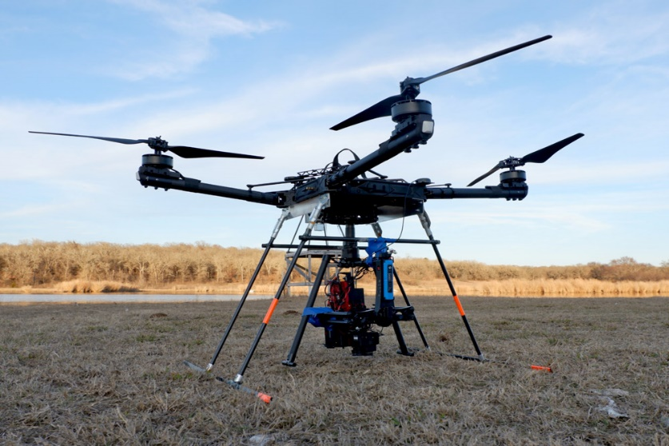
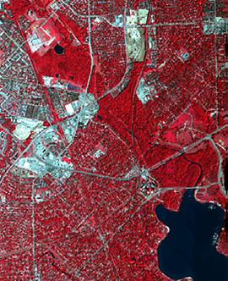
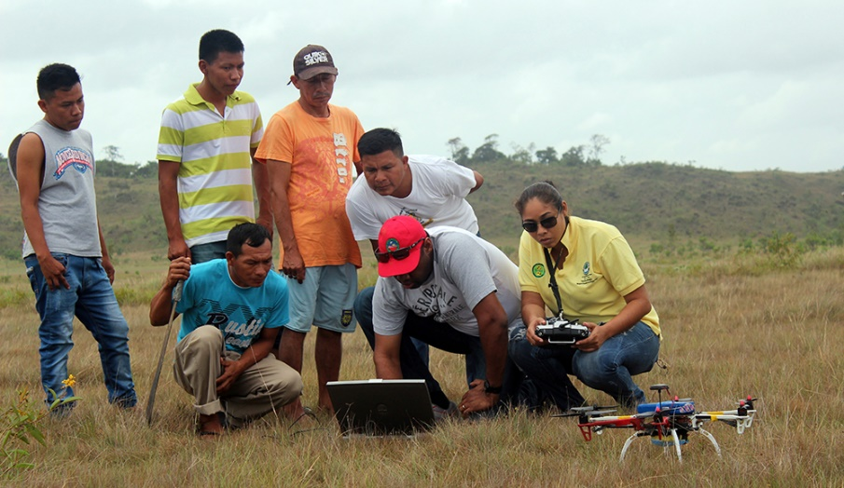
Drones at UTD
Dr. David Lary
Dr. Fang Qiu
Dr. Anthony Cummings
Notes:
Dr. David Lary:
Autonomous robotic team (includes UAV, boats, other robots)
Can be used to survey and collect data on areas that are dangerous or hard for humans to access
Could change the way that disaster sites, extreme/hazardous environments, and waterways are surveyed
Dr. Fang Qiu:
Performed a survey of Dallas’s urban forests
Used to determine type, location, and quantity of trees
Dr. Anthony Cummings:
Worked with the Makushi people in Guyana
Used drones to track how changes in farming affected the Amazonian ecosystem and wildlife over time
Sources:
Center - The University of Texas at Dallas (utdallas.edu) (Dr. David Lary)
Eye in the Sky Details Urban Tree Landscape - News Center - The University of Texas at Dallas (utdallas.edu) (Dr. fang Qiu)
Professor Uses Drones To Track Human Impact on Rainforest - News Center - The University of Texas at Dallas (utdallas.edu) (dr. anthony cummings)

Slide 7
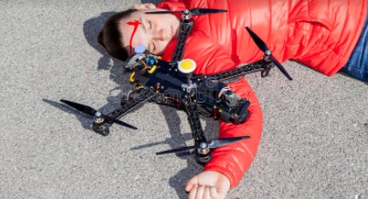
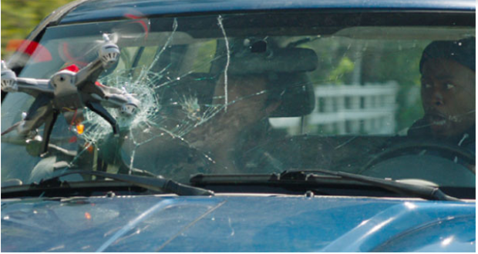
Liability considerations

Slide 8
Risk factors that can lead to accidents/liability
lost, delayed, or distorted operating signals
failure of power systems
software errors
susceptibility to hijacking and "spoofing"
midair collisions with other aircraft
This Photo by Unknown Author is licensed under CC BY-NC

Slide 9
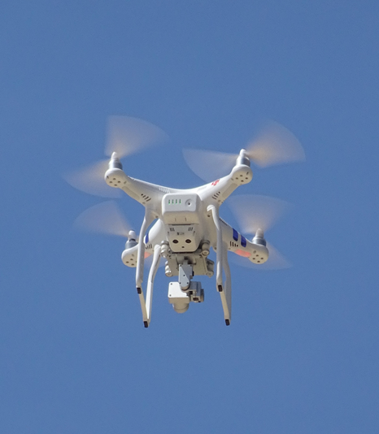
If operated by UT Dallas employee:
Texas Tort Claims Act – a governmental unit is liable for personal injuries or property damage caused by the negligent acts of its employees acting within the scope of the employment – if:
the damage or injury arises from the operation or use of a motor-driven vehicle or motor-driven equipment; and
the employee would be personally liable to the claimant according to Texas law.
Notes:
Tex. Civ. Prac. & Rem. Code sec. 101.021 (1).
State must indemnify employees for damages, costs and attorney’s fees if damages are based on an act or omission by the employee in the course and scope of their employment and cause of action is one of negligence (and not willful or gross negligence). See CPRC sec. 104.002
Limits to indemnity amounts – CPRC sec. 104.003
Defense by OAG – CPRC sec. 104.004
CPRC 108.002 – public servant not personally liable for damages in excess of $100k

Slide 10
If operated by contractor at request of UT Dallas:
Ensure contract shifts liability for negligent operation to contractor and contains standard provisions regarding insurance and indemnification
Go through Procurement for forms
This Photo by Unknown Author is licensed under CC BY-SA-NC

Slide 11
Sec. 107.9 – Duty to report accidents to FAA:
Within 10 days – if:
(a) Serious injury to any person or any loss of consciousness; or
(b) Damage to any property is greater than $500 (other than damage to the UAS)

Slide 12
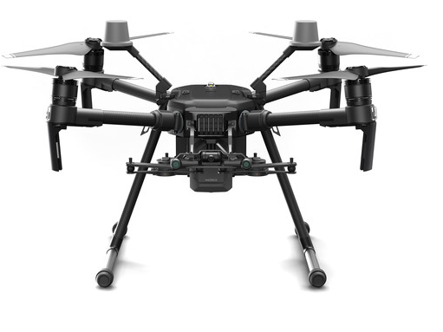
UT System Unmanned Aerial Vehicle Insurance Training
Eric Agnew – Risk and Insurance Analyst
UT System Office of Risk Management
Annette Rogers – Risk and Insurance Administrator
UT Dallas
The University of Texas System
Date – 05/04/2021

Slide 13
UT System UAV Policy Summary
UAV Policy runs from 8/13 on an annual basis
Renewal information is typically sent out in mid-June
7 Institutions plus UT System Participate
Currently 20 UAVs are covered under the UT System Policy (Liability)
15 Pieces of UAS Equipment are Covered (Physical Damage)

Slide 14
What types of UAVs are eligible for coverage?
UT Institution Owned UAVs
UAVs that are used for an Institutional Business Purpose, i.e. Research, Geological Topography Work, Aerial Inspections, Security, Search and Rescue, Land Surveying, Marketing and Communications, Mapping.
UAVs that are flown by employees who are qualified to fly under Part 107.

Slide 15
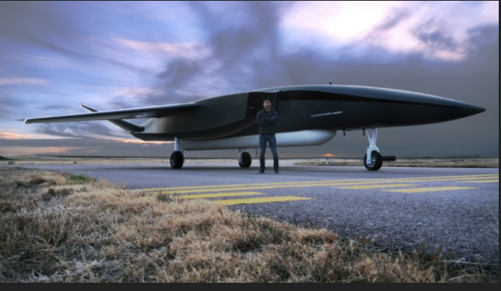
What types of UAVs are eligible for coverage? (continued)
UAVs that do not exceed 55 lbs in weight
(Pictured) The world’s largest UAV, Ravin X Autonomous Launch Vehicle (55,000 lbs)
UAVs that weigh over 55 lbs need to seek exemption under Special Authority

Slide 16
What Information Do Underwriters Need to Quote Your UAV/Drone?
Confirmation that pilots and operations are following the FAA regulations
UT Institution, Department, Contact Name and Phone Number
Year, Make and Model of the UAV and any attached equipment
Serial Number for UAVs and any attached equipment that is to be insured under the policy
If no Serial Number is available an Inventory number or some other type of Identification Number (may be pictured on the UAV)

Slide 17
What Information Do Underwriters Need to Quote Your UAV/Drone? (continued)
The Cost New of the UAV and any attached equipment must be listed separately on the Coverage Request Spreadsheet (each with Serial/ID numbers) and corresponding values
The Cost New of the UAV is typically considered the Insured Value of the UAV or the cost to replace the UAV
Description of Item if not self explanatory and what the UAV will be used for, i.e. research, aerial inspections, security, search and rescue, land surveying

Slide 18
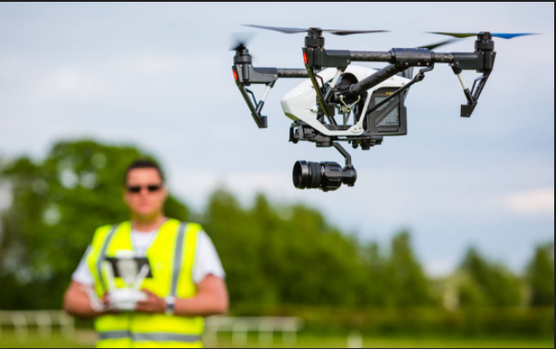
Who qualifies as a pilot under the policy?
Must be:
Approved by the Named Insured
Be appropriately Licensed for the flight being conducted
The pilot needs to know the rules in the area (country) where the drone is being flown.

Slide 19
Liability Coverage
Sums that the insured becomes legally obligated to pay as damages because of bodily injury or property damage
Each Occurrence Limit of $1,000,000; Medical Payments: $5,000 (each occurrence)
Incidents that occur during the policy period in the coverage territory (Worldwide)
Arising out of ownership, maintenance, or use of a scheduled aircraft
The insurance carrier’s duty to defend ends when limits of the policy are exhausted

Slide 20
Liability Coverage Exclusions
Expected or Intended Injury
Workers Compensation and Similar Laws (Employer’s Liability)
Damage to Property owned, occupied, rented or used by the insured or in the care, custody, or control of the insured
The policy does not include cost for search and rescue operations
Asbestos, Noise, Pollution and Contamination, Nuclear Risks, Munitions

Slide 21
Physical Damage Coverage
Physical Damage to the scheduled aircraft sustained anywhere in the coverage territory
Scheduled Payloads, i.e. quality camera equipment, Headwall Photonics GPS, Camera Gimbals
The most insurers will pay for physical damage is the least of the cost to repair the physical damage, the insured value of the scheduled aircraft or the actual cost to replace the scheduled aircraft with an aircraft of the same make and type
Theft or robbery (no deductible)
Loss by Lightning (no deductible)
Fire or explosion, while not in motion (no deductible)

Slide 22
Physical Damage Coverage Exclusions
Loss of use
Any residual decrease in value after repairs are completed (Diminution in value)
Damage confined to wear and tear, freezing, depletion, rust, corrosion, erosion, or any other form of gradual deterioration
Mechanical Breakdown
Total Loss Payout (one time per policy period)

Slide 23
Physical Damage Additional Duties
Protect damaged property
File a claim within 91 Days after a physical damage occurrence
Transfer any salvage to insurance carrier
Salvage becomes the property of the carrier. No abandonment without carrier consent
Any modifications that increase the value of a scheduled drone during the policy period must be reported to the carrier

Slide 24
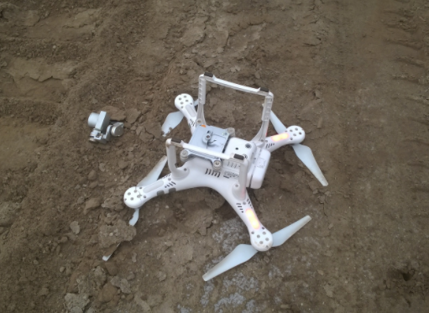
What are the Deductibles for my UAV?
5% In Motion, 5% not In Motion based on the insured value ($5,000 x 5% = $250.00)
Higher Deductibles may be charged for more expensive drones or equipment
Most expensive equipment on the current policy has deductibles of 10% of the scheduled and insured value.

Slide 25
What does DJI Refresh cover?

Slide 26
University Police Drone Registration
Currently, UT Dallas does not permit recreational flights involving drones.
Flights as part of an academic program are allowed.
Flights to capture aerial footage for a University Department are allowed.
Flights as a part of educational camps have been allowed.
Flights as a part of program development have been allowed.
In order to monitor and control drone flights to avoid flight conflict, a Drone Permit is required.
Flights are logged and Permit numbers assigned that can result in verification of the permit by patrol officers contacting police dispatch who in turn checks the permit log.
In some cases, several different flights can be under a single permit as long as the police department is notified of each flight.
Under “Online Forms” of the police web page: https://police.utdallas.edu/drone.html

Slide 27
Conclusion
UTD owned drones operated by employees must be insured for liability. At this time, departments are responsible for annual premium costs.
UTD drone contractors must provide proof of aircraft liability insurance.
All drones flown on the campus must be registered with University Police.

